Slide 1
Daniel Schenker
Why I’m Your Number One Choice As A Programmer!

Slide 2

Who I Am
Video Game Programming Student at the Art Institute of Vancouver
Snowboard Instructor
Martial Arts Instructor
Hockey player
Musician

Slide 3
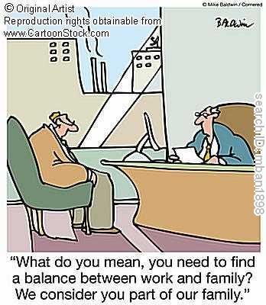
Programming and Life
I feel that I lead a very balanced life, and am comfortable both as a programmer as well as a sociable person who loves to take up leadership roles.
Almost every wise saying has an opposite one, no less wise, to balance it.
George Santayana

Slide 4
My Background in Computers
I grew up with a fascination in computer technology from a very young age.
In grade 5 I taught the computers class.
In my summer holidays, from grades 6 to 8, I went to the University of Alberta’s DiscoverE Science Camps. This was my first introduction into the world of programming where I learnt programs such as GameMaker.
My first step into the world of coding began in grade 12 where I took my first programming course in Java.

Slide 5
Post-Secondary Programming: Languages - Part 1
Java
In high school, I took my first programming course, where I was introduced to programming through Java.
C
I have a solid understanding in C, and am fully capable of programming a vast amount of C style projects, such as:
Dynamic memory management.
File and database utilities.
Algorithmic tools, such as linked list, stack, queue and binary tree traversal.
Other console programs such as chess, banking programs, as well as the ability to fully use Preprocessor Directives in order to create cleaner and easier to manage code.
Action Script
Action Script was my first scripting language I learnt, which was very beneficial as it taught me the differences between programming languages and scripting languages, thus allowing me to be able to communicate more effectively with script coders, as well as solidify my decision to specialize in programming languages, while still learning enough in scripting languages to be completely competent.

Slide 6
Post-Secondary Programming: Languages - Part 2
C++
In C++ I have learnt how to effectively utilize multiple inheritance, polymorphism and encapsulation, as well as other key C++ concepts such as operator overloading, using the STL and more.
I have made a fully functional bitmap utility program that is very versatile as it can load, create, read, edit, save, crop, etc, both virtual and actual bmp files.
I have created a multi-threaded client-server chat utility, using both TCP and UDP. I have also learnt a bit about peer-to-peer networking.
I have made a puzzle game titled Super Slider which implements both multiple game states, as well as my bitmap utility program, through the use of Peter Chan’s SGE (Simple Game Engine) which is based off of DirectX 9.

Slide 7
Post-Secondary Programming: Languages - Part 3
C#
In my Programming For Game Engines course, I used C# in Unity to create a first person shooter adventure game title Blast Through, in which I scored a perfect score for the entire course.
I am the technical director of a game titled Batteries Not Included, which is being designed in Unity using C#.
PHP
I have used PHP to write a program that uses WiX to build Microsoft Installer packages.
Game Maker Script
I have studied Game Maker Script, in order to be able to create advanced prototypes for more complicated games.
The game I am the technical director of (titled Batteries Not Included), used Game Maker as a prototype tool.

Slide 8
Post-Secondary Programming: General Computing
Computer Architecture
I have a deep understanding of how computers work (as well as other electronic devices). This includes:
The history of computer development.
How each individual part works.
The entire build process of a game.
WiX
Can use Windows Installer Extensible Markup Language to create Microsoft Installer packages.
Batch Files & NAnt
I have used batch files to write programs that use NAnt to automate build processes.

Slide 9
Post-Secondary Programming: Documentation and Design Process
Documentation
UML
Game Design Documents
Technical Design Documents
Development Processes
Strong understanding of the software development cycle
Agile Development
Waterfall Development
Currently creating a full game with a team of fifteen plus members using the Waterfall Development process.
Test Driven Development
Achieved 98% in a course in which this methodology of coding was taught and required.
Testing Methods
Static and Dynamic Testing.
Unit Testing, Integration Testing , System Testing, Regression Testing, Acceptance Testing and Smoke Testing.
Test Case Design, Black Box Testing, White Box Testing.

Slide 10
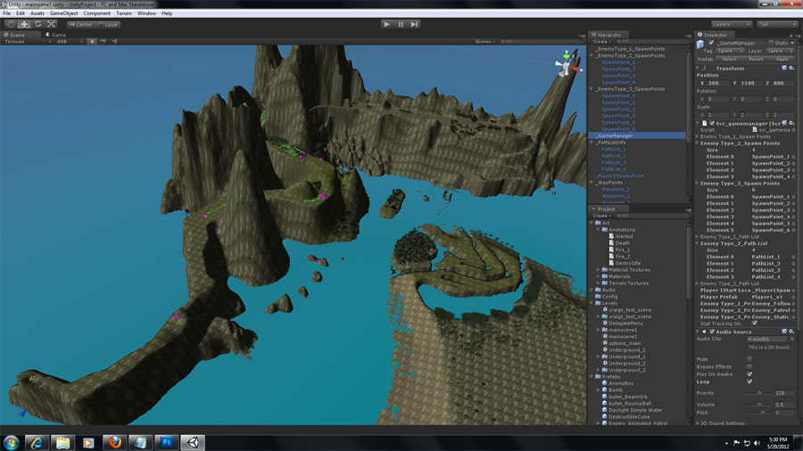
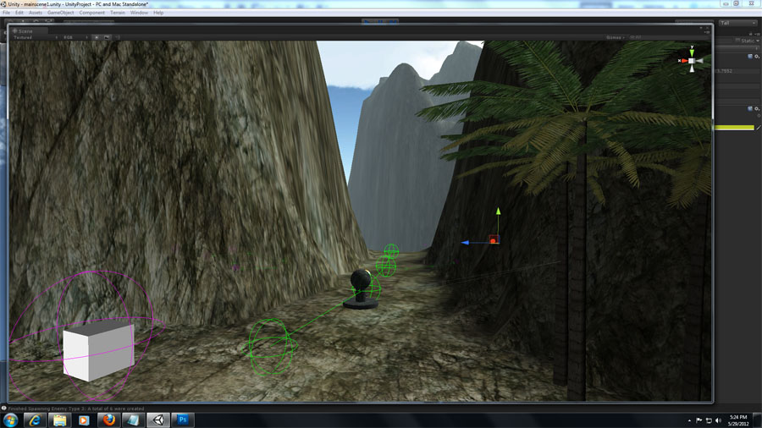
Blast Through!
Blast Through Design Documents

Slide 11
My Education Outside of Programming
I have always had great interest in aerospace, which led me to study a lot of math and physics.
This comes in very handy, as I would like to specialize as a physics engine programmer.
At my first college, I studied psychology on the side, which expanded my ability in understanding how other people think, and why people like, and do the things that they do. This is very beneficial in game design as it allows me to be able to design games that other people would want to play, not just myself.
I took part in the Royal Canadian Air Cadets for a couple years, which then led me to attend flight school the year after I graduated (through Prairie Bible Institute)
This is very useful for physics engine programming, as I now have a greater understanding of flight, weather and other related physics.

Slide 12

My Life: Sports
I love to stay busy, constantly doing things. As a result, I took part in almost every sport throughout my life.
My position in these three sports really helped shape me into the great leader I am today. I learnt how to become a teacher that can clearly explain, motivate, and teach others in a variety of situations, with a great deal of responsibility on my shoulders.
The sports I focused on the most were:
Hockey, where I eventually went on to win MVP at a provincial level in my grade 12 year, where I got the provincial gold medal goal.
Martial Arts, where I taught TaeKwonDo up to 2nd degree black belts without being a black belt myself due to not having enough time experience as a martial artist to be eligible.
Snowboarding, where I became the first person in Canada to become officially certified without my own snowboard, as I had to use a rental board.

Slide 13
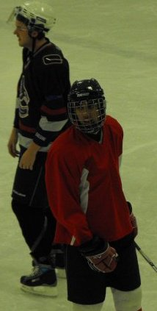
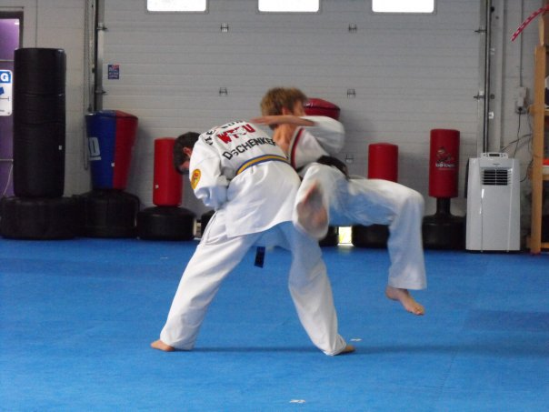
Sports Pictures

Slide 14
My Life: Music
I grew up in a musically talented family.
I played many different instruments throughout the years, such as piano, guitar, saxophone, electric bass, percussion, double bass and lastly, my favourite of them all, drums.
My musical abilities greatly benefit me as a programmer, since a lot of video game review scores are heavily influenced by the music in a game. I have taken some time to learn about game specific music. This allows me to be able to do audio programming and music creation for games as well.

Slide 15
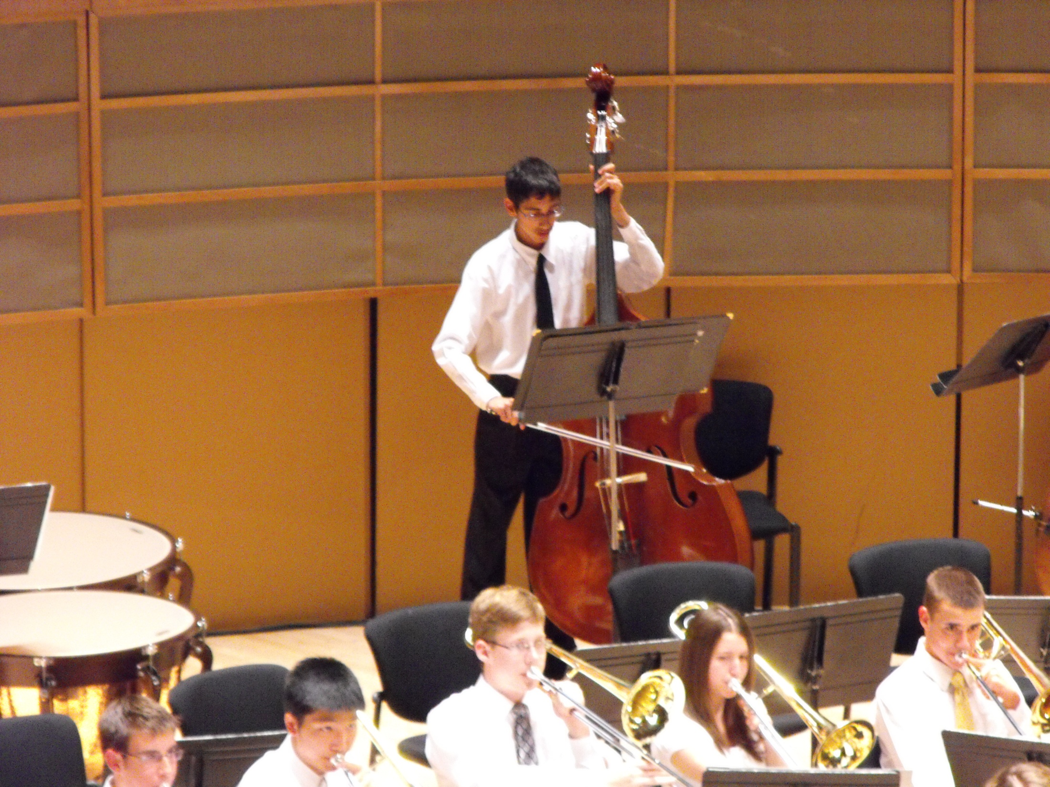

Slide 16
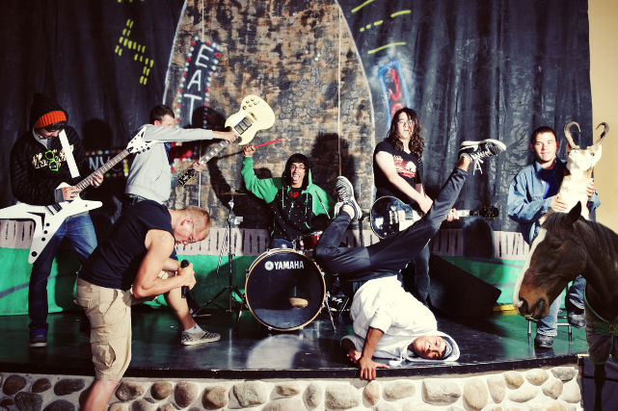

Slide 17





Work History

Slide 18
Conclusion
Combining my love for computers, enthusiasm for mathematics, my vast interest in learning, desire to take part in as many unique activities as possible, excellent virtues of being a fun, hard working, kind and smart person, I believe this makes me the ideal candidate as your next programmer!
Thank you for taking the time to listen to my presentation.
Daniel Schenker
778-986-5527
D.A.Schenker@gmail.com

